Slide 1
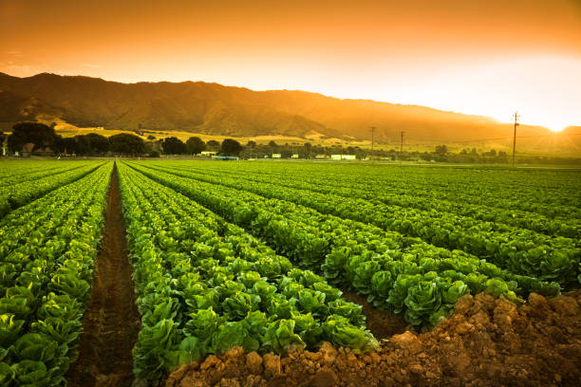
OBJECTIVE
This project is used to extract information from agriculture data and to give suggestions regarding crops and make future decisions so that agriculture can be carried out in a planned manner.

Slide 2
TECHNOLOGIES USED
SQL Server Integration Services(SSIS)
Azure Blob Storage
Azure Data Bricks
Azure Database
Azure SQL Server
Azure Data Factory
Power BI

Slide 3
CAPABILITIES
Sl.No. | KOs | FUNCTIONALITY | RELATED QUESTIONS
1. | Cleaning and transforming data for processing | SSIS | 1,2,5,7
2. | Extract, Transform and Load data
3. | Transform Data with Data Flow Operations
4. | Integrate Advanced Control Flow Operations
5. | Configuring and Deploying SSIS Packages
6. | Provisioning and deploying relational database in Azure | AZURE (AZURE SQLDB) | 1,2,3,4,5,7,8,9,10
7. | Data storage and processing data in Azure Blob storage | Azure blob storage
8. | Executing SSIS packages in data Azure data factory | AZURE DATA FACTORY
9. | Analysis on medium/large data sets using databricks | AZURE DATABRICKS
10. | Connect to azure SQL Database and creating data models in Power BI | POWER BI | 1,2,6,7,8
11. | Improving the data model for reporting by establishing relationship between tables
12. | Adding different visualizations and interactivity in reports
13. | Creating reports and designing dashboard for users

Slide 4
Suicide dataset
State
2010
2011
2012
2013
2014
SCHEMA DIAGRAM
Rainfall
State
Year
Annual Rainfall
Crop cultivation
State
District
Year
Season
Crop
Area
Production
Area of Cultivation
Year
Rice
Jowar
Bajra
Maize
Ragi
Wheat
Barley
Gram

Slide 5
PROBLEM STATEMENTS
1. Finding trends in crops in terms of production, area.
2. State wise suicide rate of the farmers
3. Which year has Highest cultivation of Pulses
4.Which year has Highest cultivation among rice, wheat and coffee.
5. Which state yields highest crop per year?
6. Finding how different factors like temperature affect production
7. Year wise suicide rates of farmers
8. Which state receives highest rainfall in which year and what is the annual rainfall?
9. Crop wise cost of cultivation versus cost of production
10. Highest crop production in particular season

Slide 6
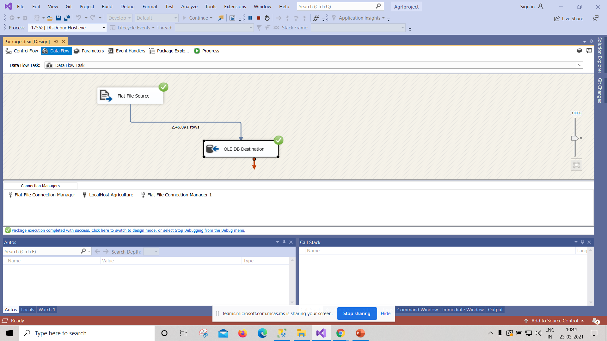
1. Finding trends in crops in terms of production, area.
a). State wise production
Implementation: SSIS, Azure SQL database, Power BI
Data preparation:-

Slide 7
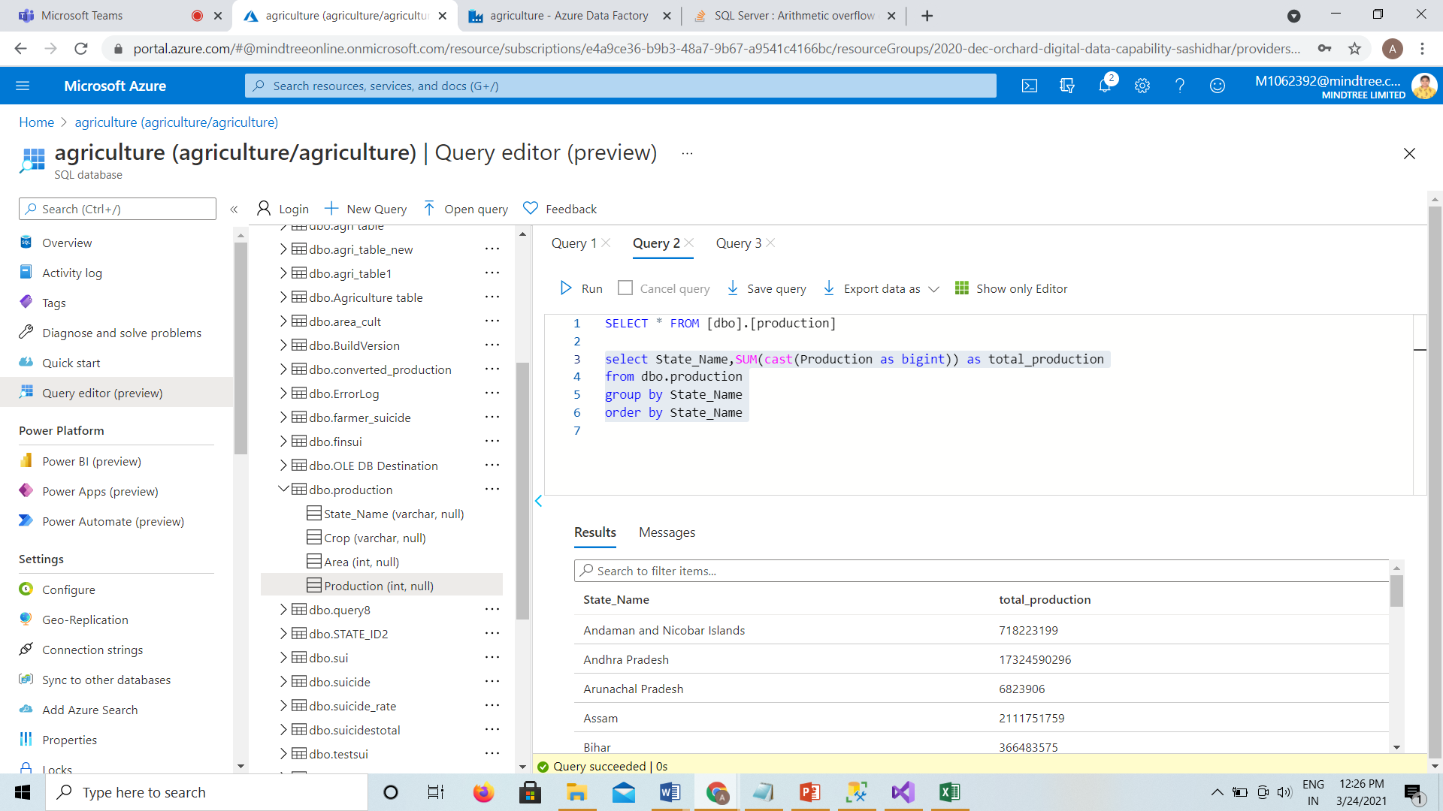
Query and output:-
select State_Name,SUM(cast(Production as bigint)) as total_production
from dbo.production
group by State_Name
order by State_Name

Slide 8
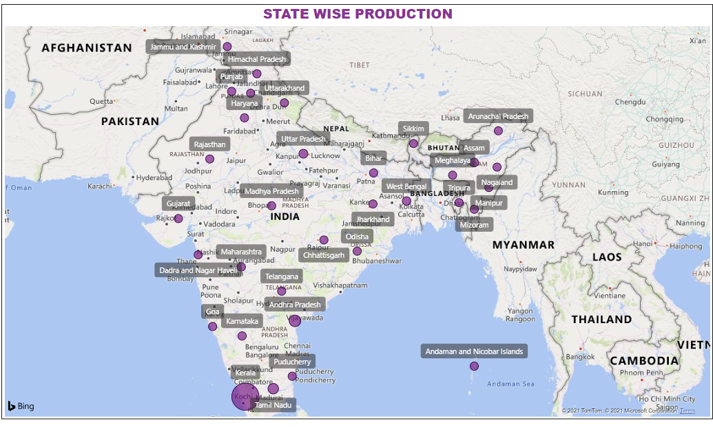
Visualization in power BI

Slide 9
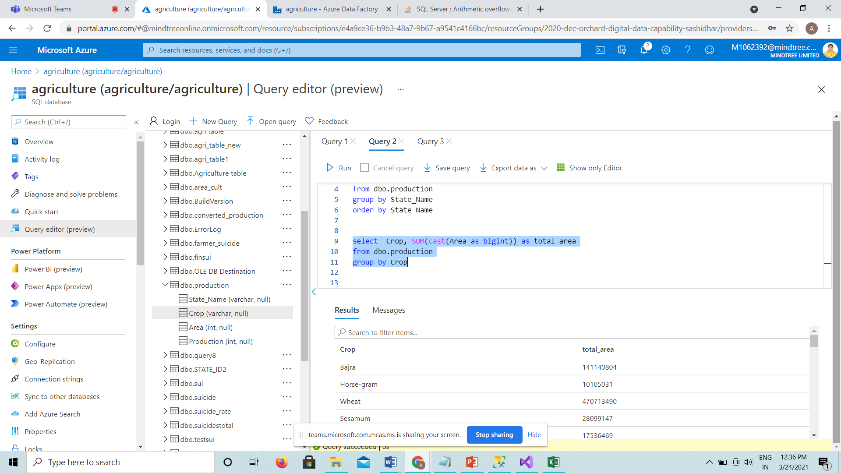
b). Area wise crop production
Query and output:-
select Crop, SUM(cast(Area as bigint)) as total_area
from dbo.production
group by Crop

Slide 10
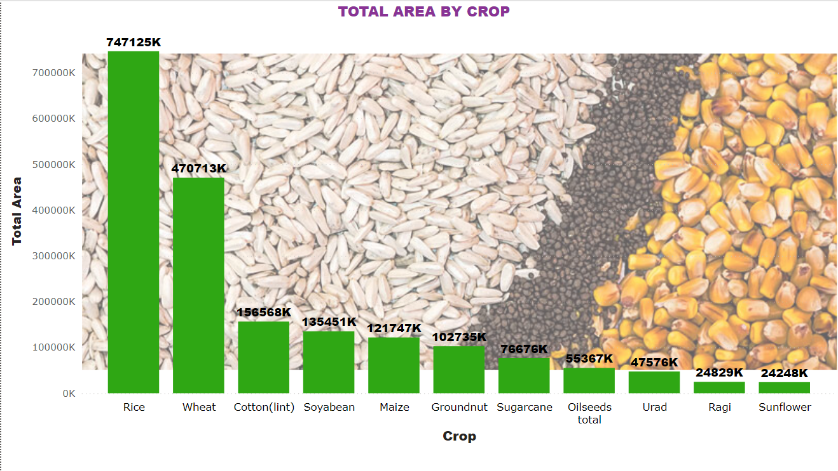
Visualization in power BI

Slide 11
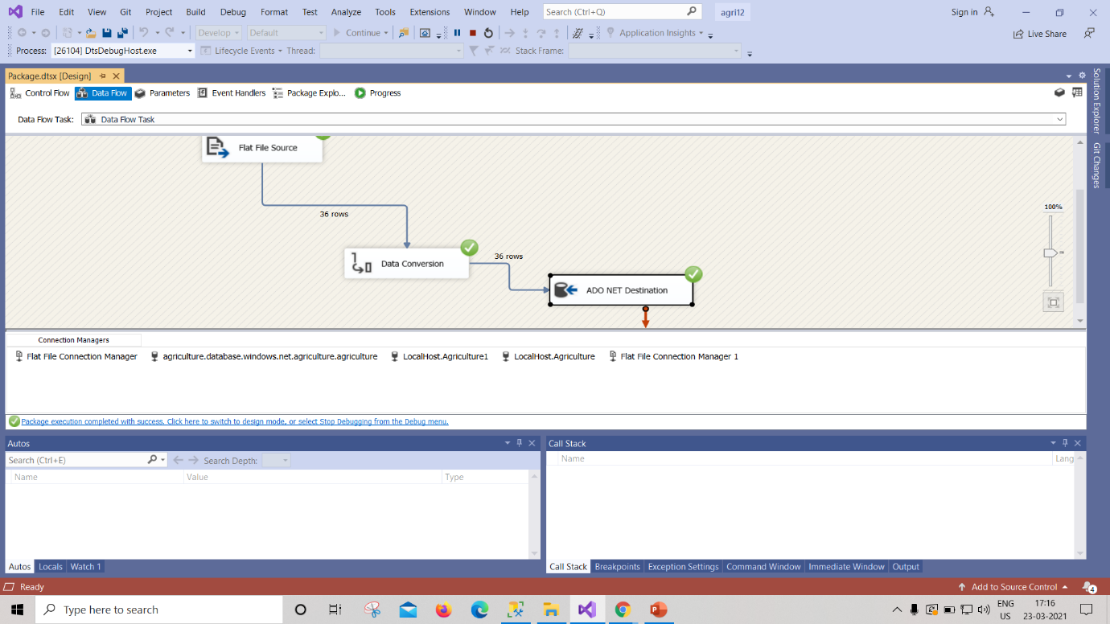
2. State wise suicide rate of the farmers.
Implementation: SSIS, Azure SQL database, Power BI
Data preparation:-

Slide 12
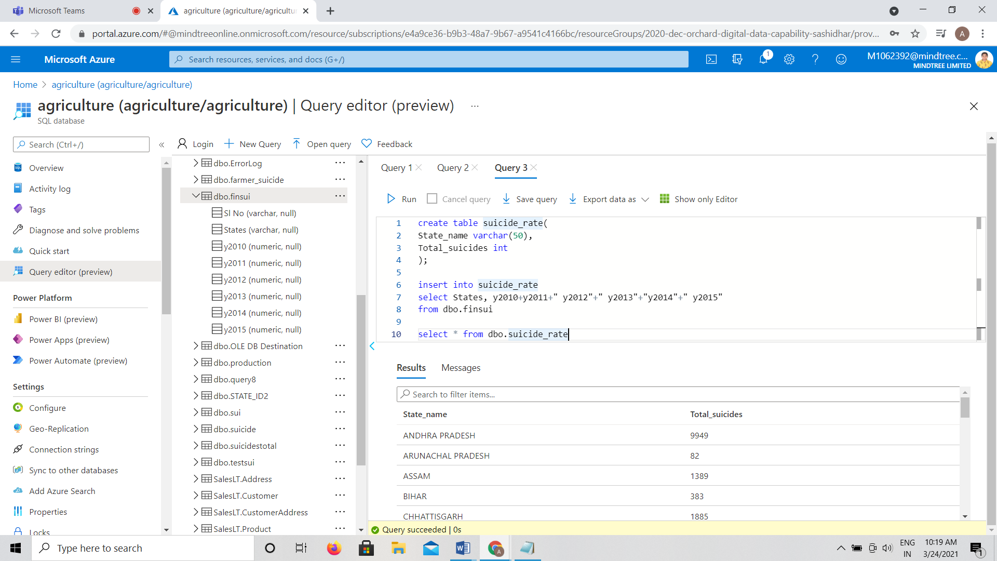
Query and output:-
select States, y2010+y2011+" y2012"+" y2013"+"y2014"+" y2015"
from dbo.finsui

Slide 13
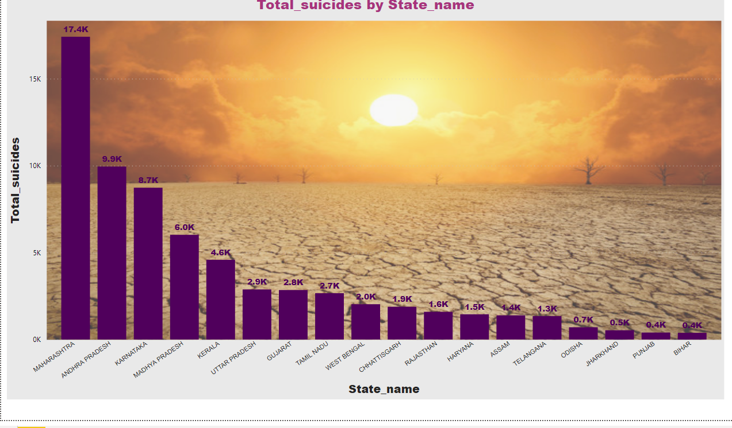
Visualization in power BI

Slide 14
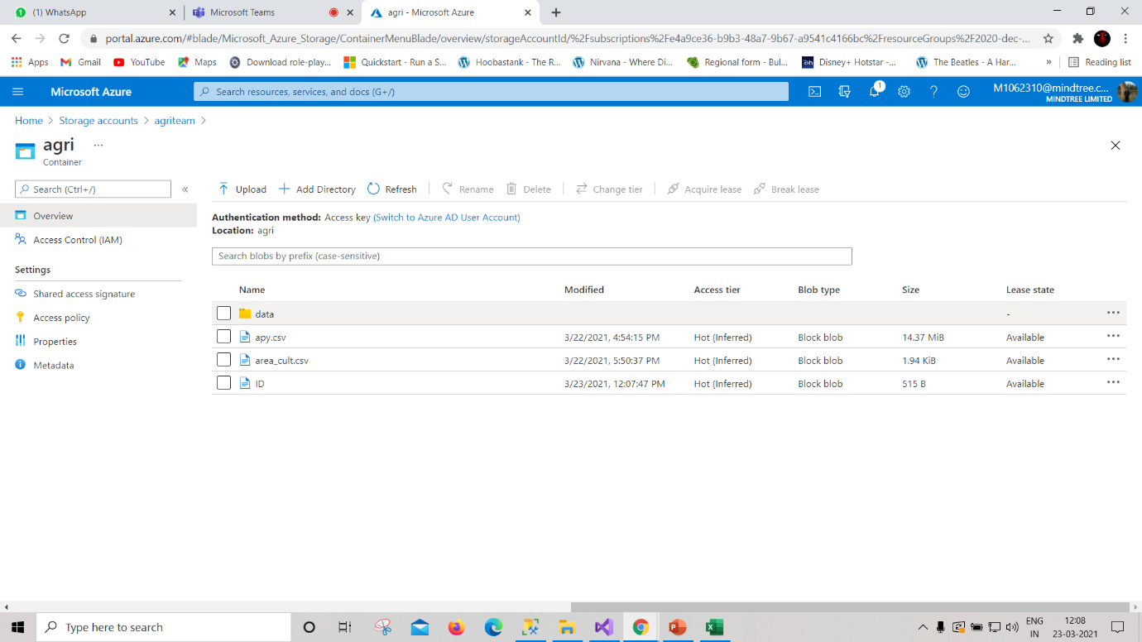
3. Which year has Highest cultivation of Pulses
Implementation: Azure blob storage, Azure Databricks
Data preparation:-

Slide 15
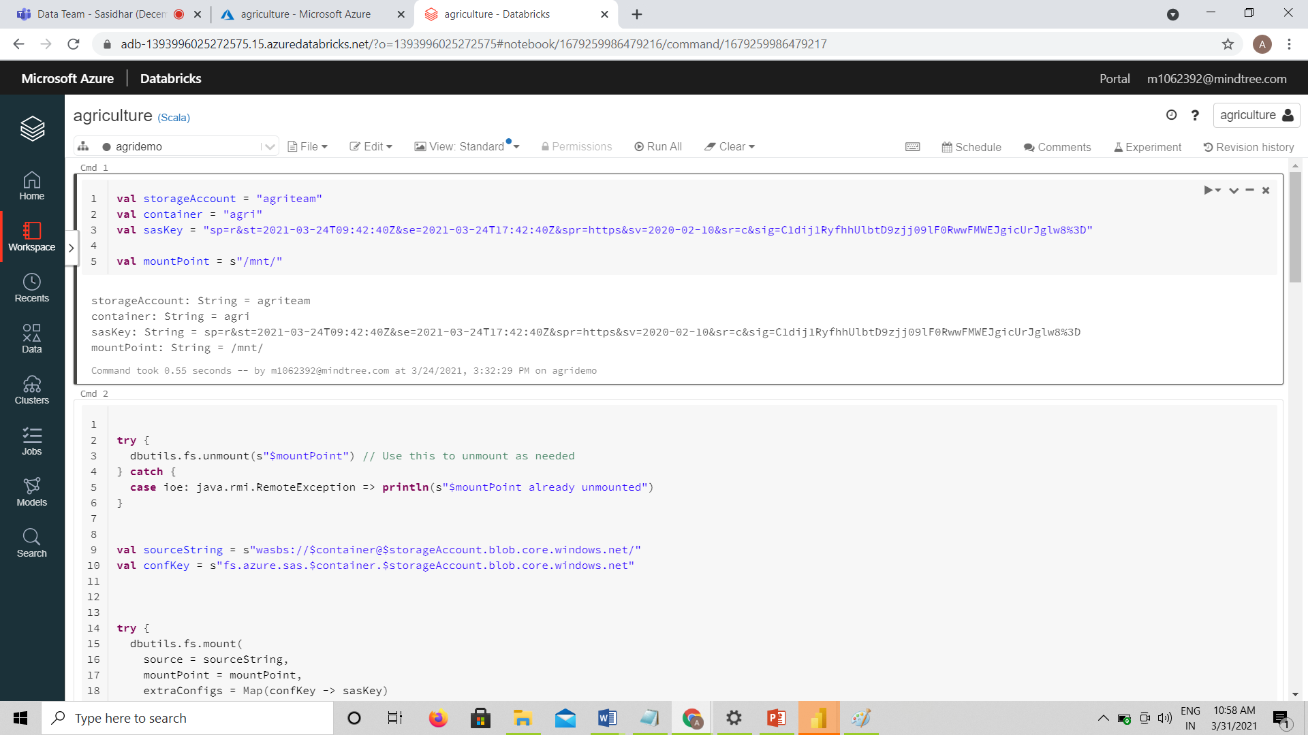
Connecting Azure blob storage to Azure databricks

Slide 16
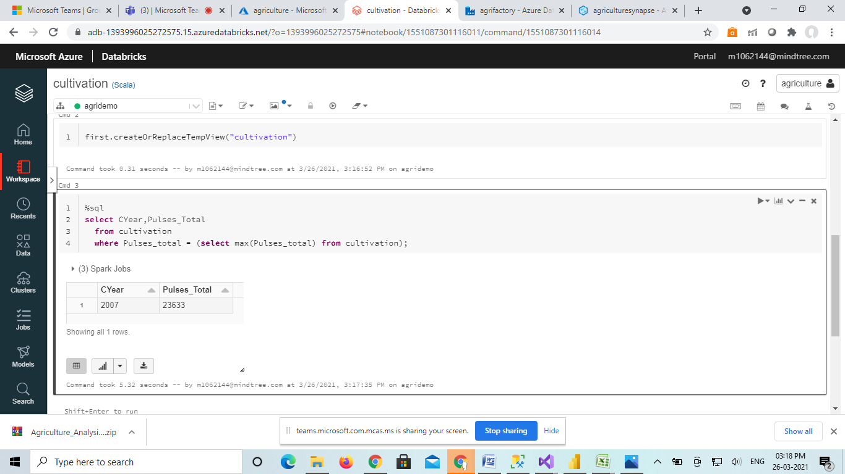
select CYear,Pulses_Total
from cultivation
where Pulses_total = (select max(Pulses_total) from cultivation);
Query and output:-

Slide 17
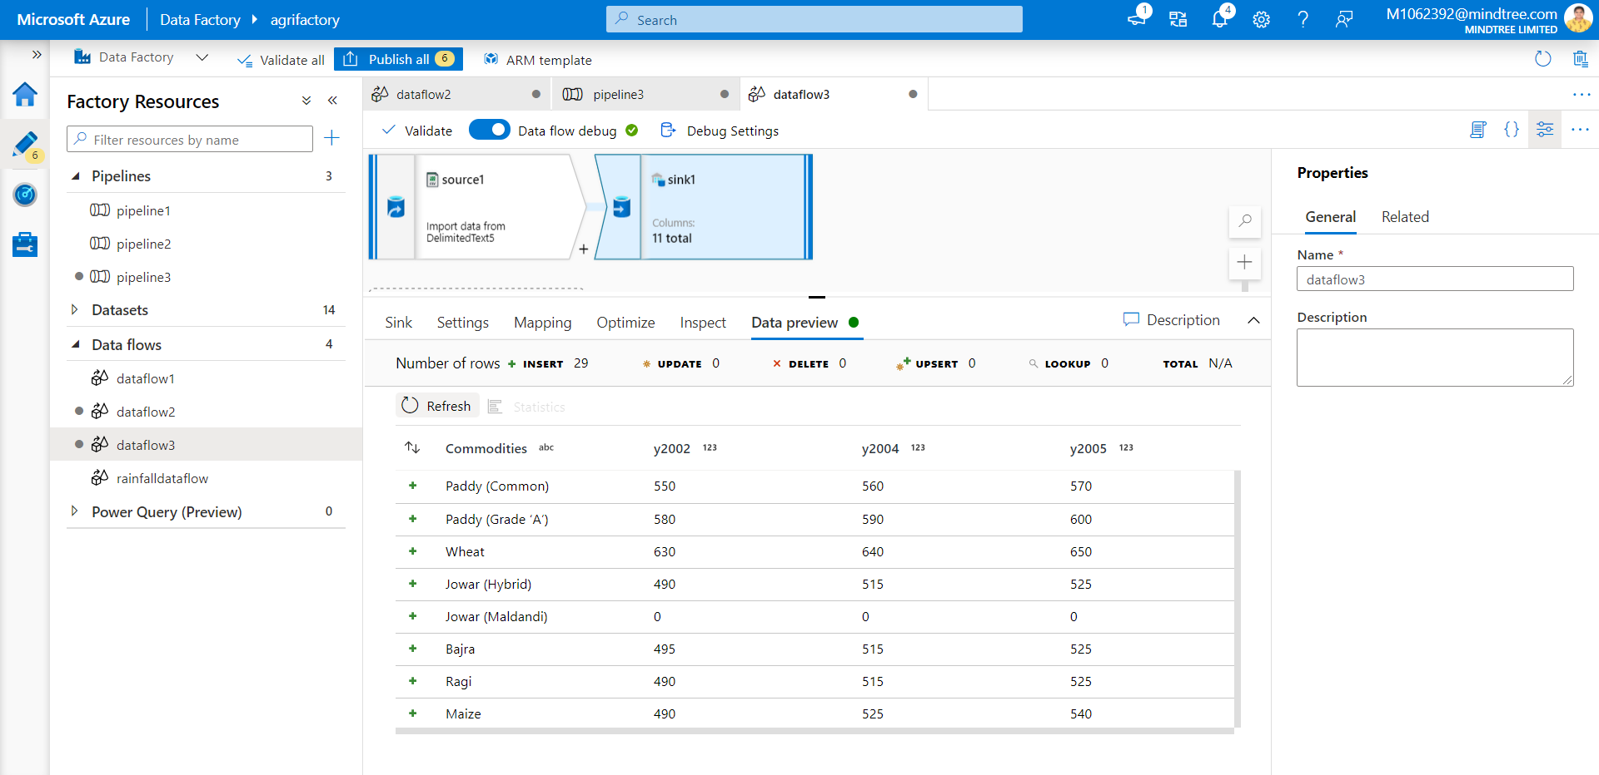
4.Which year has Highest cultivation among rice, wheat and coffee.
Implementation: Azure blob storage, Azure data factory, Azure Databricks
Data preparation :-

Slide 18
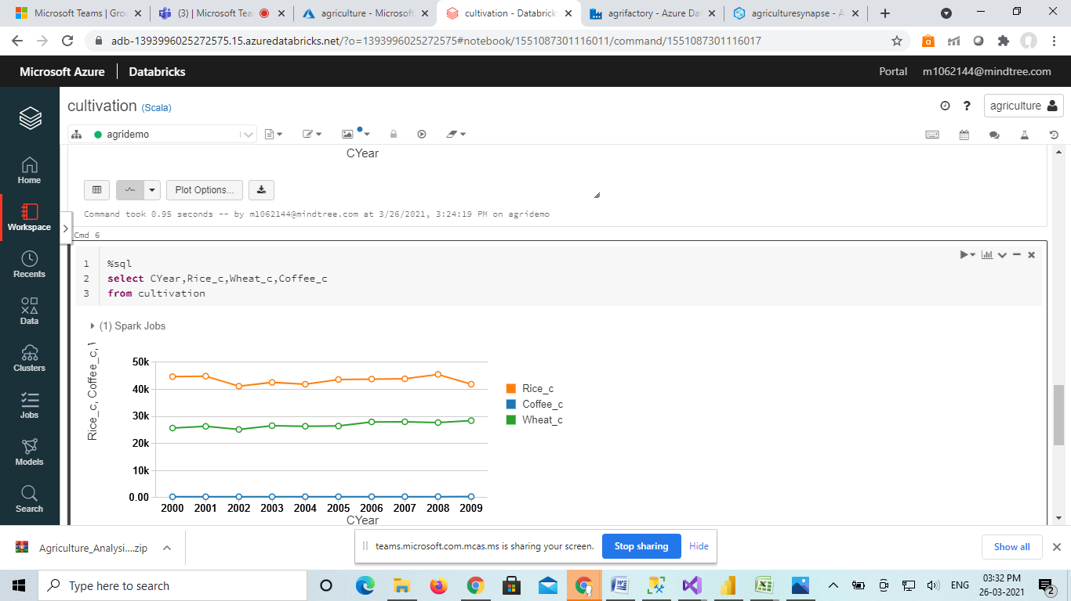
Query and output:-
select CYear,Rice_c,Wheat_c,Coffee_c
from cultivation

Slide 19
5. Which state yields highest crop per year?
Implementation: SSIS,Azure SQL database, Azure Databricks
Data preparation :-

Slide 20
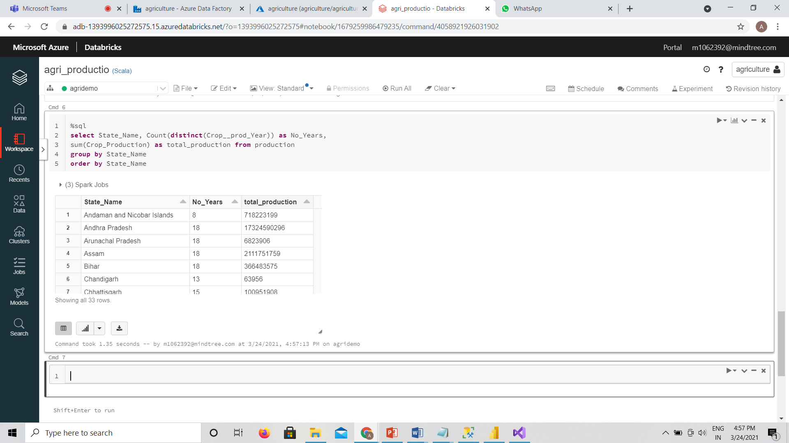
Query and output:-
select State_Name,
sum(Crop_Production)/Count(distinct(Crop__prod_Year)) as production_per_year
from production
group by State_Name
order by State_Name

Slide 21
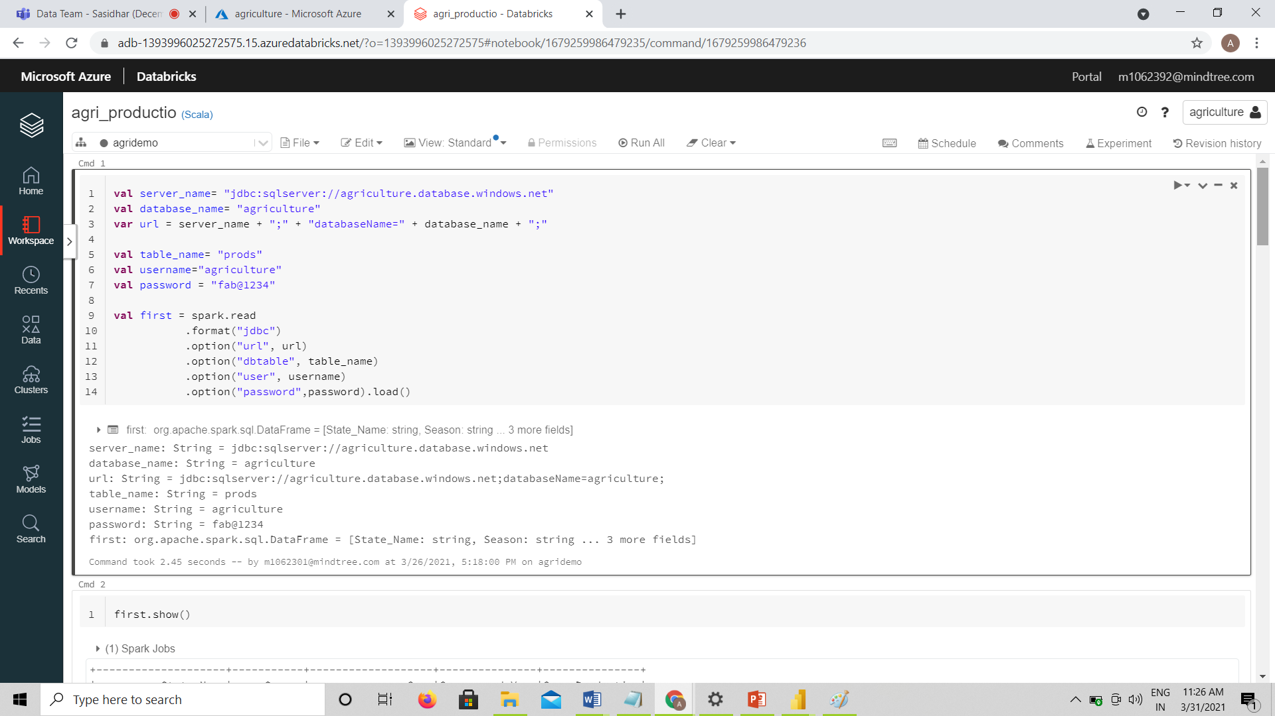
Connecting Azure SQL database to Azure databricks

Slide 22
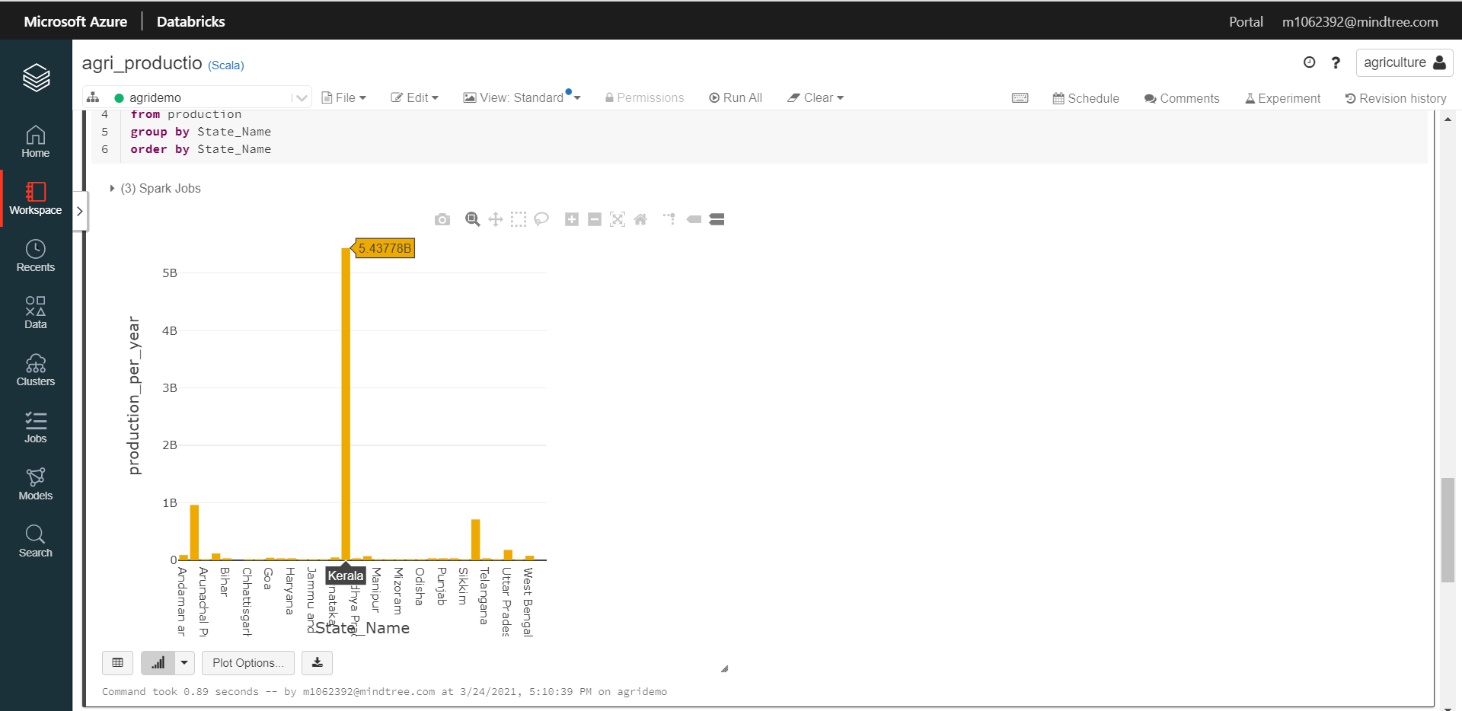
Visualization in Azure databricks

Slide 23
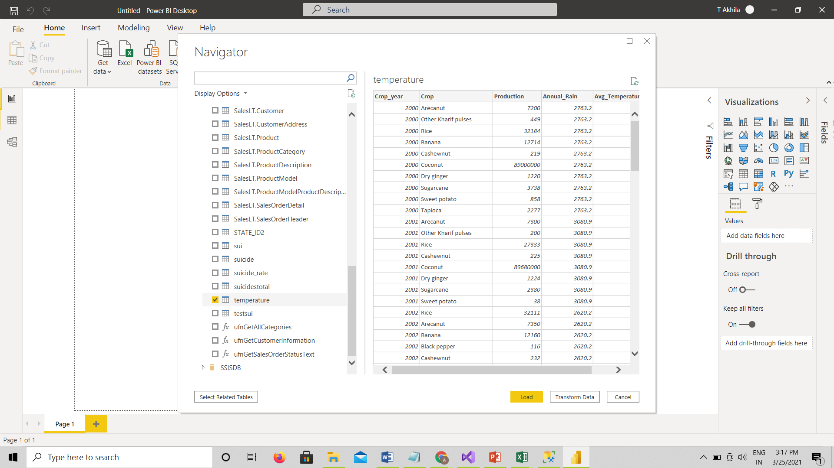
6. Finding how different factors like temperature affect production
Implementation : Azure SQL databse,Power BI
Data preparation :-

Slide 24
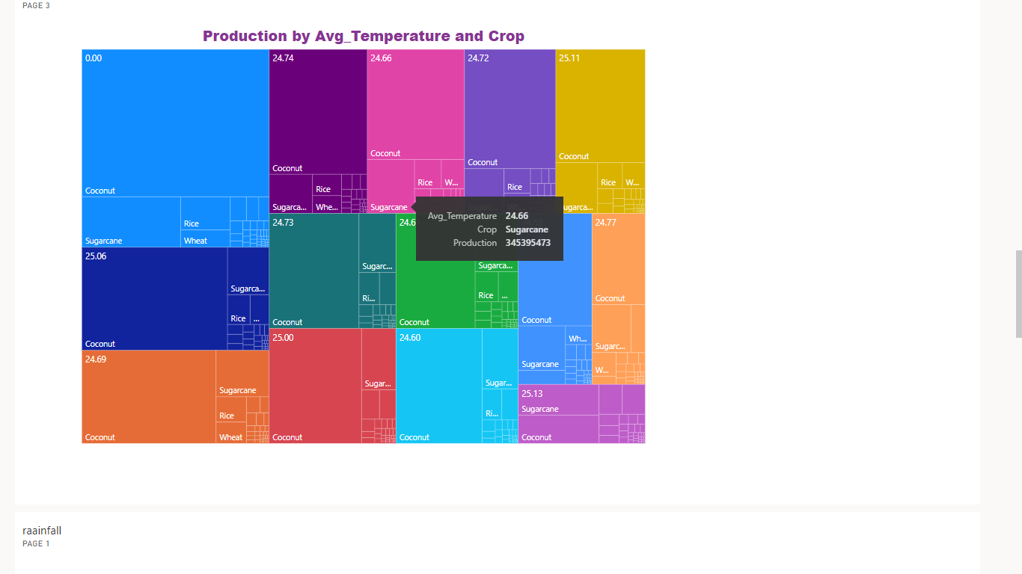
Visualization :-
Factors: a). Temperature

Slide 25
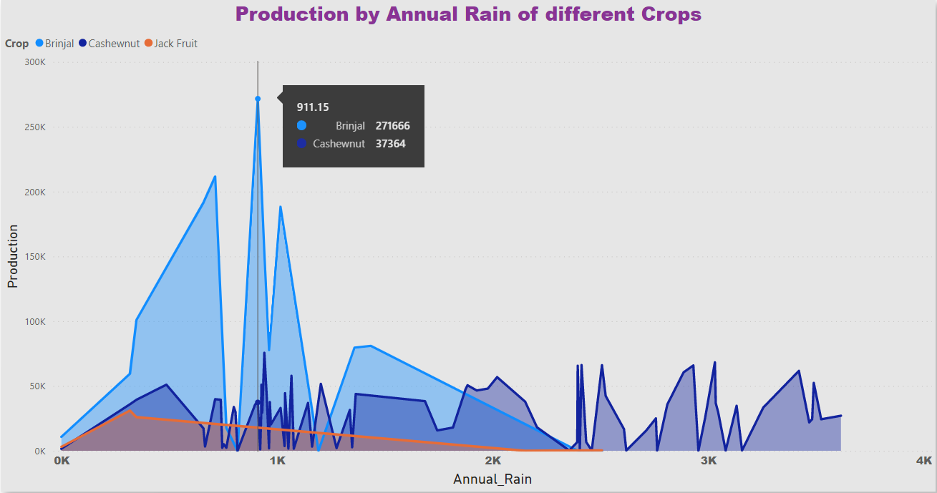
Visualization :-
Factors: b). Rainfall

Slide 26

7. Year wise suicide rates of farmers
Implementation :SSIS, Azure SQL database ,Power BI
Data preparation :-

Slide 27
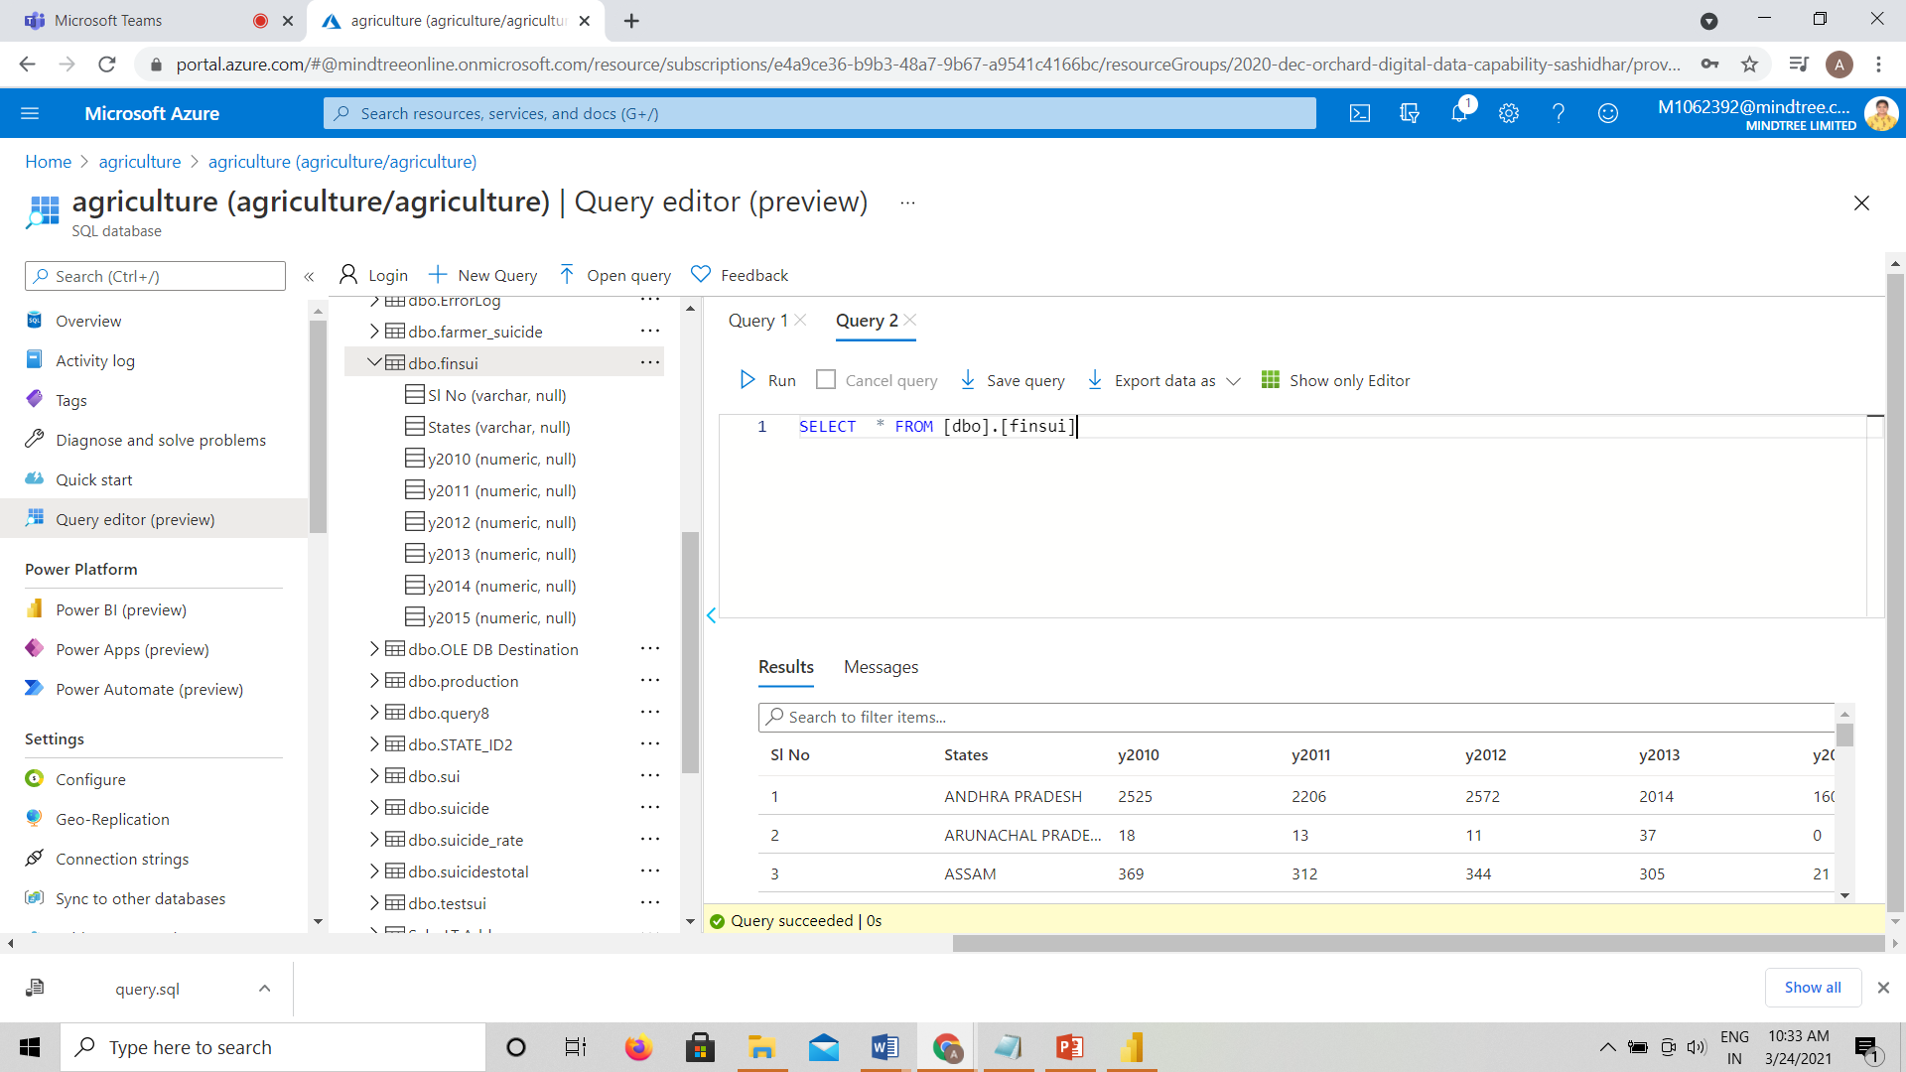
Query and output:-

Slide 28
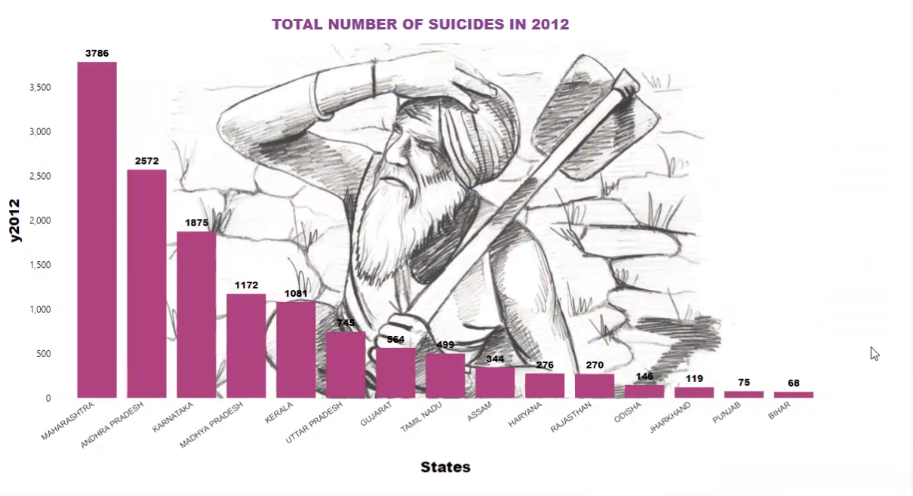
Visualization:-

Slide 29
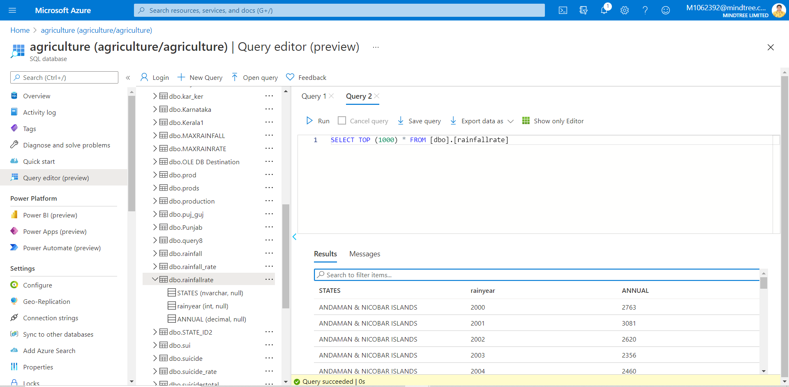
8. Which state receives highest rainfall in which year and what is the annual rainfall?
Implementation : Azure SQL database, Azure Databricks, Power BI
Data preparation :-

Slide 30
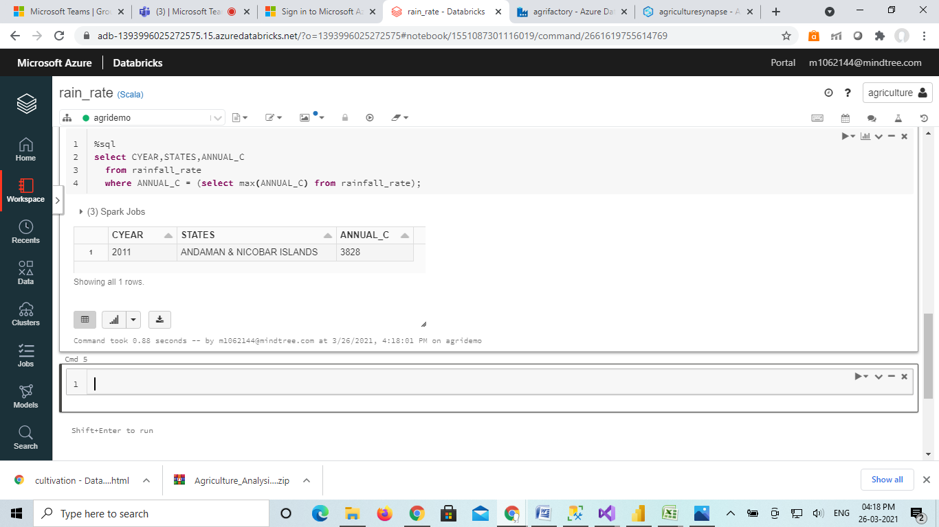
Query and output:-
select CYEAR,STATES,ANNUAL_C
from rainfall_rate
where ANNUAL_C = (select max(ANNUAL_C) from rainfall_rate);

Slide 31
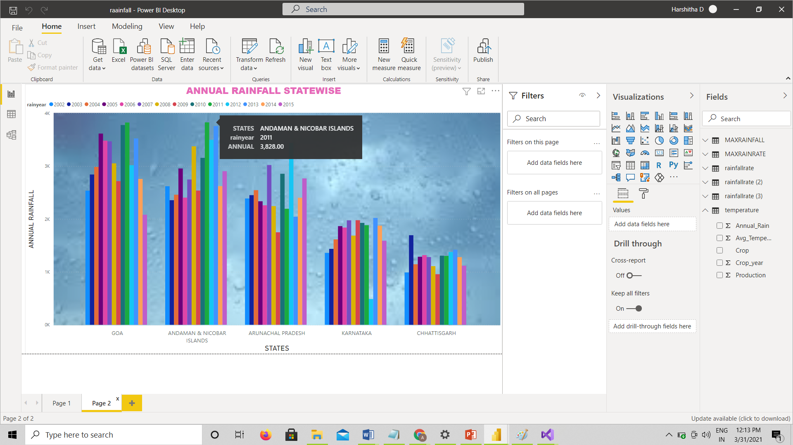
Visualization:-

Slide 32
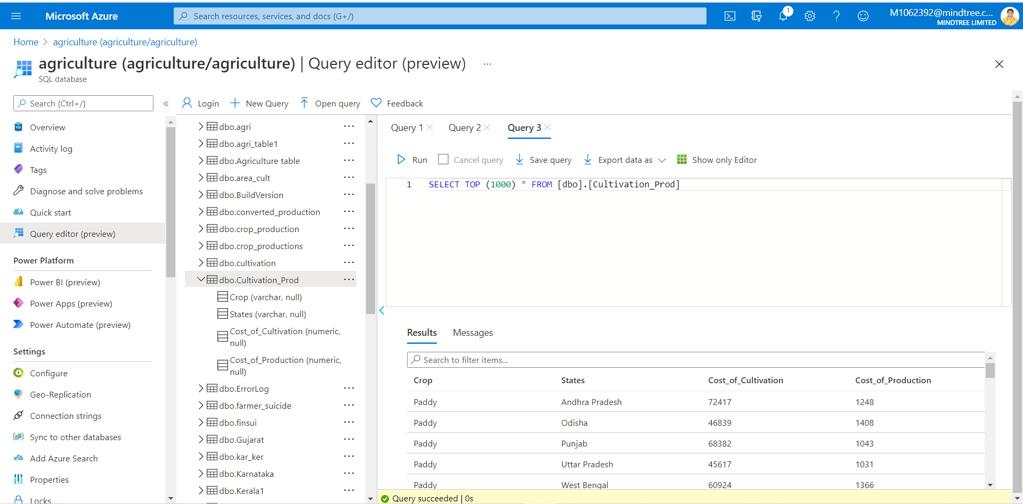
9. Crop wise cost of cultivation versus cost of production
Implementation : Azure SQL database, Azure Databricks
Data preparation :-

Slide 33
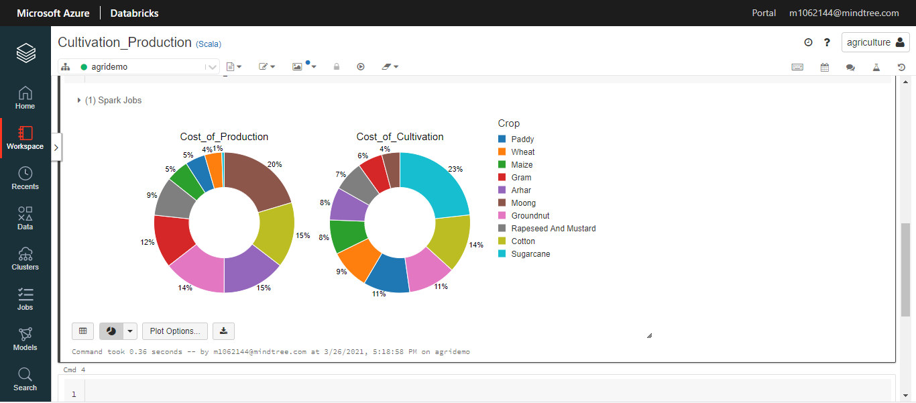
Visualization in Azure databricks:-

Slide 34
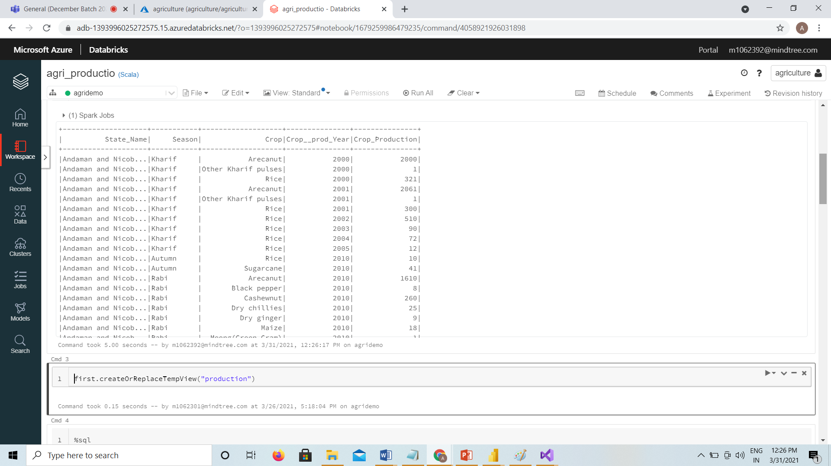
10. Highest crop production in particular season
Implementation : Azure SQL database, Azure Databricks
Data preparation :-

Slide 35
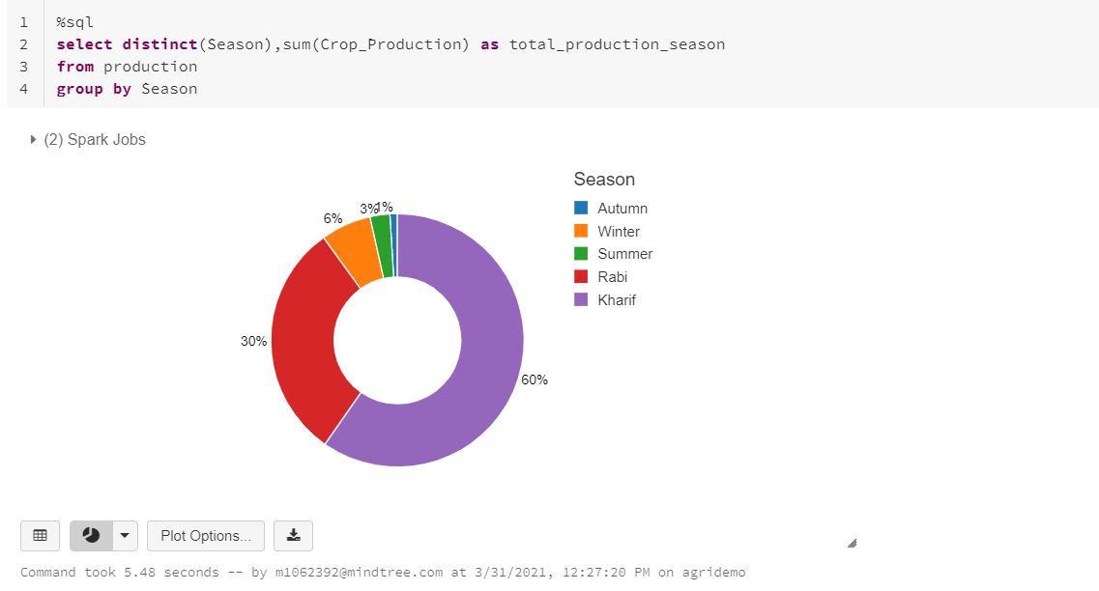
Query and output:-
select distinct(Season),sum(Crop_Production) as total_production_season
from production
group by Season

Slide 36
REFERENCES
https://www.pluralsight.com/
https://docs.microsoft.com/en-us/azure/?product=featured
https://www.edureka.co/blog/microsoft-azure-tutorial

